Slide 1
Reconciliation
Compilers Autumn 2002

Slide 2
Review
Two modes of consistency
  Strict consistency: e.g. cache of multi-core
  Eventual consistency: e.g. cache of DNS
RSM & SSM
  RSM: all the nodes are the same
  SSM: master & slaves (only one real logic)
Quorum
  Q_{r} + Q_{u} > N_{replicas}
Compilers Autumn 2002

Slide 3
Reconciliation
Constraint of replicas: ---→ identical
Hard to maintain
  Data can decay
  RSM may experience an error
  Update algo may be interrupted before eventual consistency
  Administrator’s misbehavior
  User makes change when disconnected
Reconciliation: makes the replicas identical again
Compilers Autumn 2002

Slide 4
Reconciliation using Comparing
Comparing is complicate
  Comparing is expensive, optimizations are complicate
  A crash during reconciliation can be worse than no reconciliation
  Conflicts may exist
    Depending on how much the algo knows about the semantics
    Some must be solved by person
  Decay may strike ----- reconciliation system
Reconciliation Modularity
  Detecting differences among the replicas
  Resolving the differences, making all replicas identical
Compilers Autumn 2002
Notes:
Decay may strike records kept by the reconciliation system

Slide 5
Occasionally connected operation
A laptop is often not network-connected
  Different state : only one changes.
  Conflict state: both change
Recall concurrency control methods
  Pessimistic: mark them as “check out” on desktop
  Optimistic:
Reconciliation is needed either way
  E.g. calendars on PDA, file synchronization, etc.
Compilers Autumn 2002
Notes:
Recall concurrency control methods
Pessimistic: identify all files needed on laptop, mark them as “check out” on desktop
Optimistic: allow either computer to update any file, detect and resolve conflicts next time

Slide 6
Occasionally connected operation
Detect differences and conflicts
  Read both and compare bit-by-bit (expensive)
  Witness: calculate the hash of the file
    Can also support a decay detector
  Time of last modification
    Cannot discover decay
    Undo may also change the timestamp
    Clocks may drift
  Generation number in metadata
Compilers Autumn 2002
Notes:
Generation number in metadata
Global-wide current generation number
Likely to require modifying the file system

Slide 7
Last check time = 2016/08/08
LEFT | RIGHT
1111 （stamp= 2016/02/02） 2222 (stamp= 2016/09/02)
555 （stamp=2016/11/3） Com1（stamp=2016/11/3） Com2（stamp= 2016/09/01） | 555 （stamp= 2016/01/01） Com1（stamp=2016/11/3） Com2（stamp= 2016/09/04）
 | 333（stamp= 2016/02/01） 444 (stamp= 2016/09/01)

Slide 8
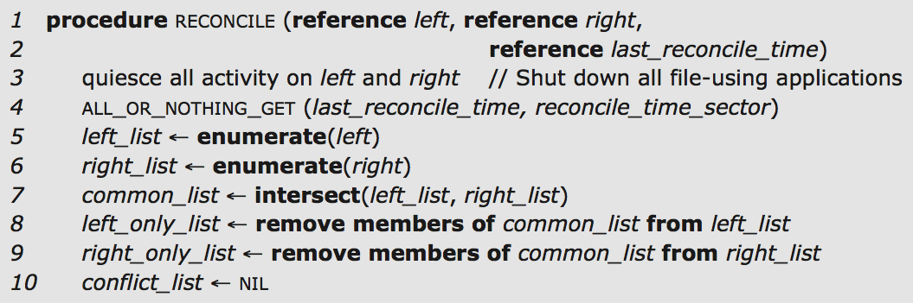
Reconciliation procedure
last_reconcile_time
MODIFICATION_TIME(file) returns time of last modification
enumerate: list all files
Compilers Autumn 2002

Slide 9
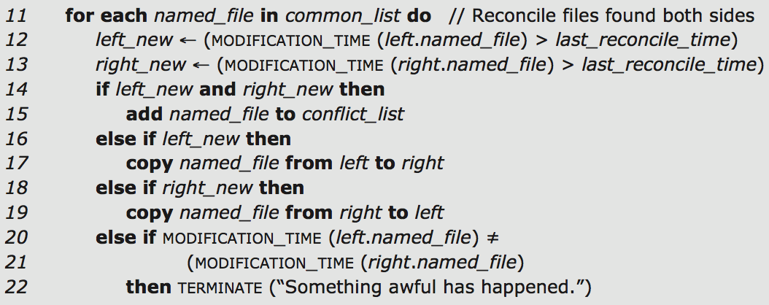

Reconciliation procedure
copy must be atomic
RECONCILE must run by itself
Compilers Autumn 2002

Slide 10
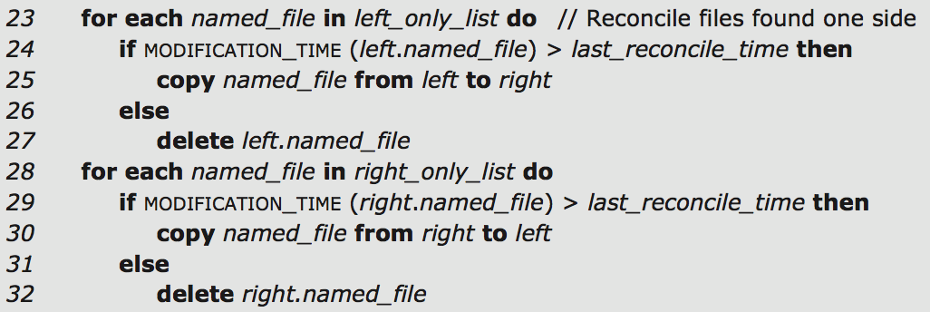

One side deletes an old file,
the other side creates a new file, or
one side modifies a file that the other side deletes
Another choice: marked conflicted
Compilers Autumn 2002

Slide 11
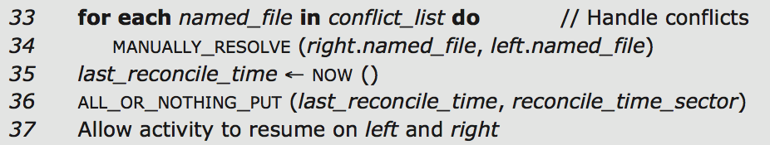
Occasionally connected operation
Handle conflicts
Record last_reconcile_time
Compilers Autumn 2002

Slide 12
Improvements
give user the conflict list, let user to resolve later
  No assurance that the user reconciles the conflicts
Solve some conflicts algorithmically
  Must understand application semantics
  e.g. conflicts of calendar files①
  Require developer providing a reconciliation procedure
Apply to directories, links, metadata
  Link, instead of copying
  Many differences in directories can be resolved by algo
Compilers Autumn 2002
Notes:
give user the conflict list, let user to resolve later
No assurance that the user reconciles the conflicts
. conflicts of calendar files:
the left computer create a new appointment, the right computer also add another new appointment
---merge is good
Calender:

Slide 13
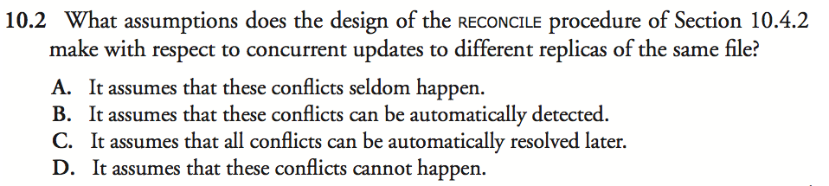
Compilers Autumn 2002

Slide 14
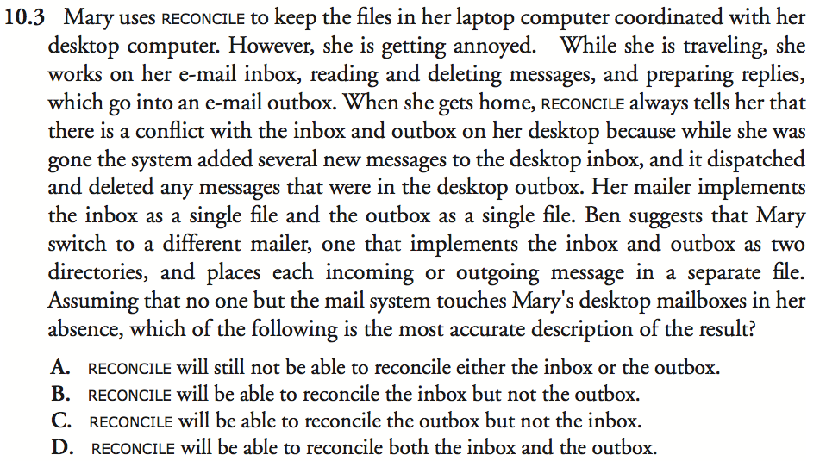
Compilers Autumn 2002

Slide 15
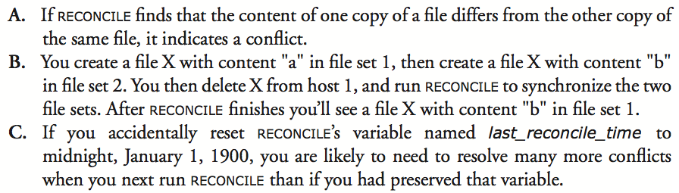
Compilers Autumn 2002

Slide 16
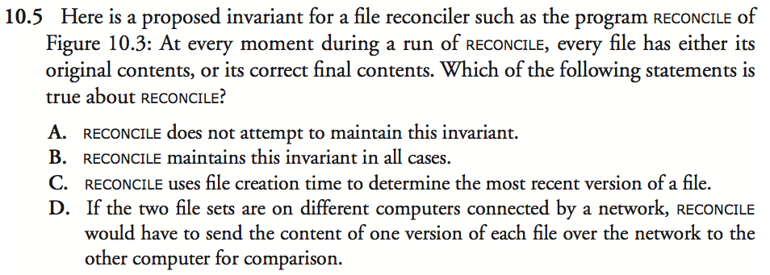
Compilers Autumn 2002

Slide 17
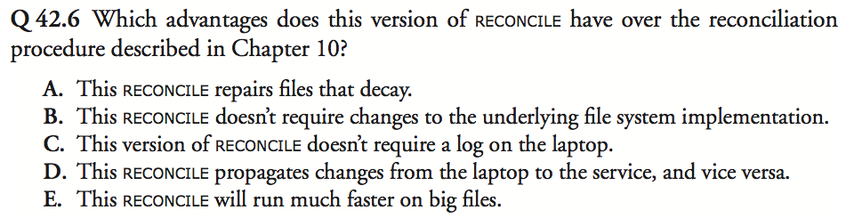
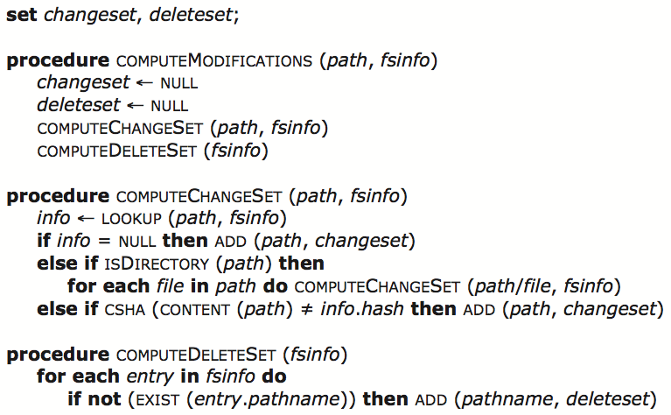
Compilers Autumn 2002

Slide 18
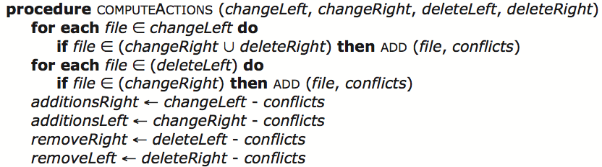
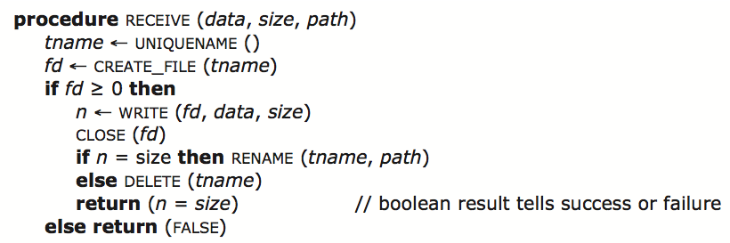
Compilers Autumn 2002

Slide 19
Perspectives
How these ideas related to the real world?
  History
  Trade-offs
  Unexplored topics
Compilers Autumn 2002

Slide 20
History
Concurrency
  50s: IBM 7030 & TX-0 at MIT with I/O interrupt
  60s: Time-sharing system
Coordination
  Edsger Dijkstra’s semaphores
  Per Brinch Hansen’s message buffers
  David Reed and Raj Kanodia’s eventcounts
  Nico Habermann’s path expressions
  Anthony Hoares’s monitors
Compilers Autumn 2002

Slide 21
History
Failure recovery
  Durable storage
    Backup medium: magnetic tape etc.
    Periodically backup
    Incremental backup scheme
    Develop salvager programs to go through the disk and repair damage
  Database requirement
    Develop the concept of a transaction
      Initially was exactly an all-or-nothing action
      Then add before-or-after
        Which leads to version history, provide both recovery and coordination with a single mechanism
Compilers Autumn 2002

Slide 22
Trade-offs
End-to-end argument
  If the higher-layer user makes other mistakes
  No point to implement heroic coordination correctness
  E.g. cornflakes inventory
  E.g. Federal Reserve Bank
Optional locking protocols
  Cursor stability, read committed, snapshot isolation
  Can’t bound the maximum damage, too risky
Boundary of correctness
  Not in three generations of CPU design (50s, 60s, 70s)
Compilers Autumn 2002

Slide 23
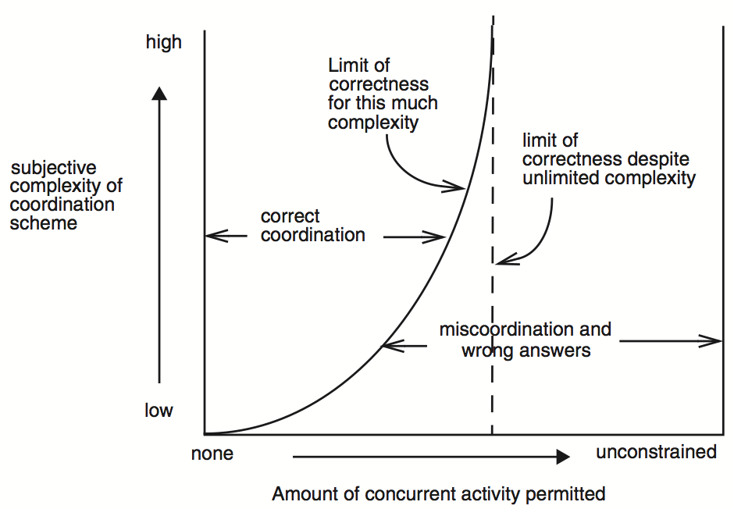
Compilers Autumn 2002

Slide 24
Further study
Hierarchical composition
  Lower level atomic actions: each has its own lock point, coinciding with its own commit point
  Higher level transaction: has a lock point too, need rearrangement of the order of the locks
  Contradicts modular composition!
Solution
  Lock manager needs to know the hierarchical atomic action
  Lock manager rearrange the order of lock release
    E.g. relabel a lock to show it is held by a higher layer
  More complex
Compilers Autumn 2002

Slide 25
Further study
Systematic specification of tolerance of coordination errors has not been explored
  Perform a visible action that reverses all known effects of some earlier visible action
  How to track the error flow?
Byzantine general’s problem
  Not all nodes are trying to reach a consistent, correct result, some are trying to mislead
    E.g. in replica storage
    Important in P2P network
Compilers Autumn 2002

Slide 26
One more thing: some suggestions
How to keep staying ahead?
  News: Reddit, Hacker News
  Q&A: Quora, Stack Overflow
  Forums: tektalk, InfoQ, CSDN, V2EX, Zhihu, ...
  Blogs: mindhacks, coolshell, matrix67, ...
  Conferences: OSDI, SOSP, ASPLOS, USENIX ATC, ...
How to be organized?
  Use Evernote, as early as possible
  GTD: Things, G-Calendar, RTM, ...
Keep digging & critical thinking
Compilers Autumn 2002

Slide 27
Modules of RSM
  One module for consensus-achieving algorithm
  One set of modules (FSM) to perform the updates
  One module for reconciliation
A
B
C
R
B
C
A
B
C
R
R
A
A
B
C
R
Consensus
FSM
Reconciliation
Compilers Autumn 2002

